Slide 1
Session 5

Slide 2
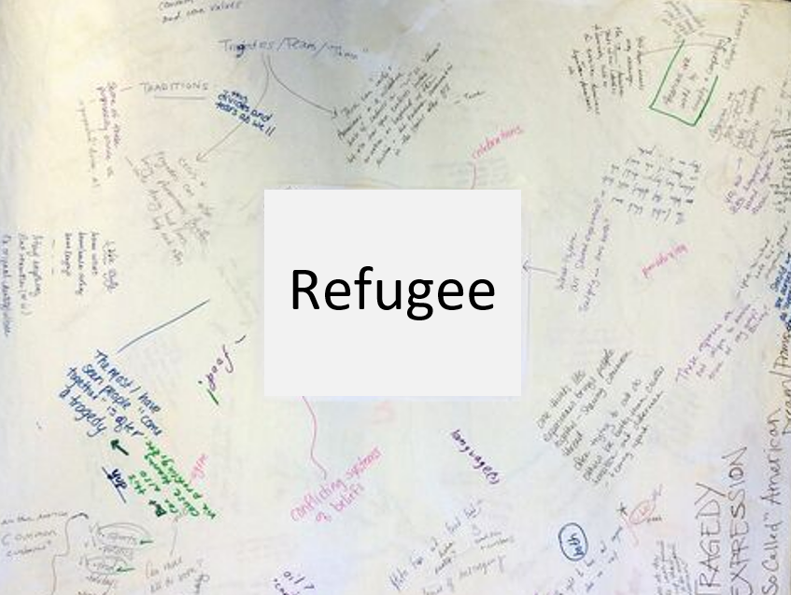
Graffiti Wall

Slide 3
Online Poster Exhibition
I have some very exciting news!
You are all going to take part in an online art exhibition. The exhibition will be a display of posters created by each of you.
Have a think about everything that you have learnt throughout these sessions:
Have your views towards refugees changed?
Do you know more than you did before?
What have you learnt?
How can we use kindness to help others?
Paintings of refugees given to 'show hosts' generosity' - BBC News

Slide 4
Online Poster Exhibition
So let’s take a look at our poster criteria:
Shows understanding and empathy towards refugees and their situation
Is eye catching and engaging. It draws you in and makes you interested in understanding about refugees and their situation
Digital or clear photo of artwork (so it can be digitalised)

Slide 5
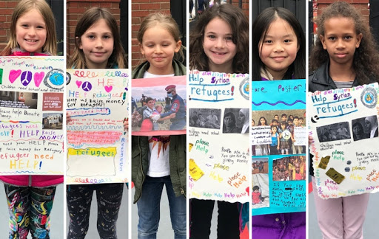
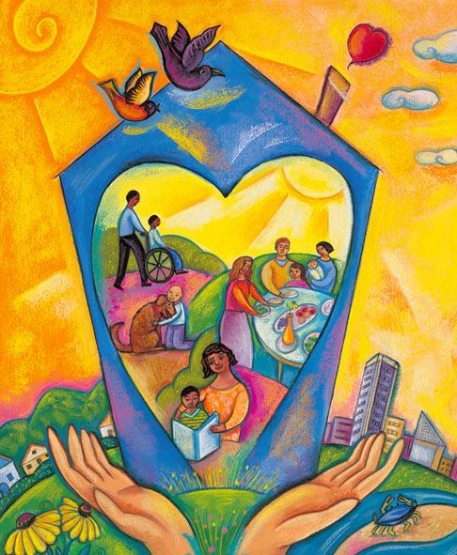







Online Poster Exhibition

