Slide 1

Session 2

Slide 2

Understand how perceptions based on nonfactual beliefs and generated negative emotional responses can lead to prejudice and hatred.
LO: To use features of a letter
SC:
I can write in first person and past tense
I can organise my writing in paragraphs
I can use informal language
I can express emotions and opinions

Slide 3
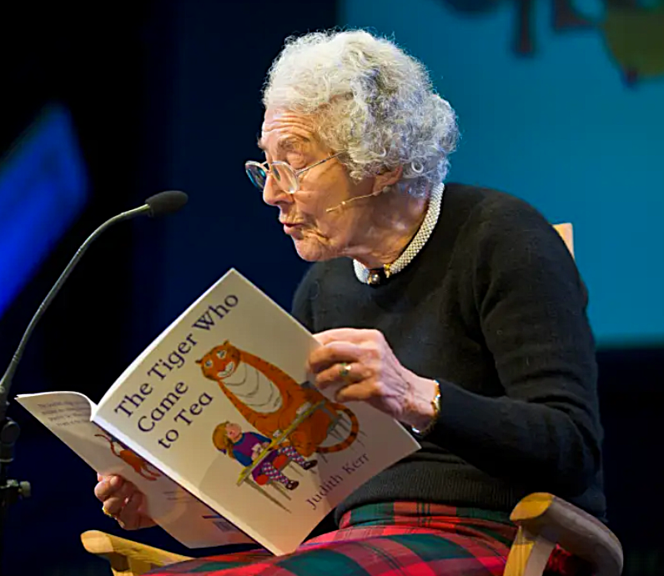
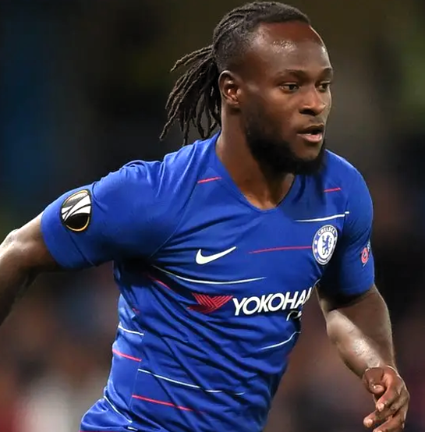
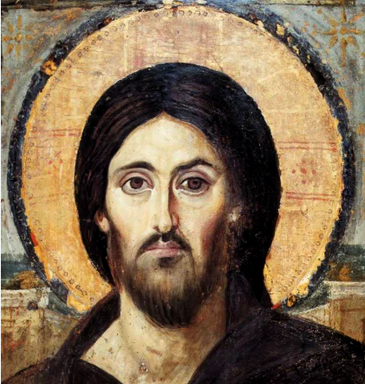
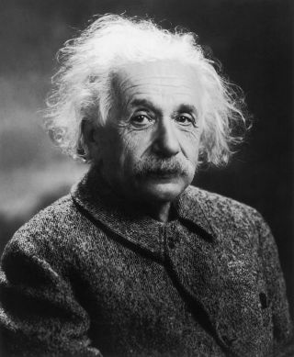
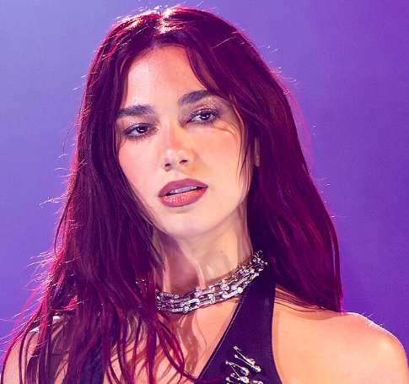
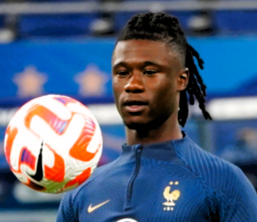

Look at these images. What do all of these famous people have in common?
Judith Kerr Author
Victor Moses Footballer
Jesus
Albert Einstein Scientist
Dua Lipa Singer, Song Writer
Eduardo Camavinga Footballer
They are
all refugees

Slide 4
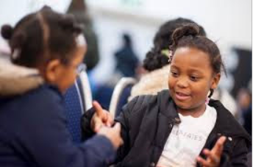
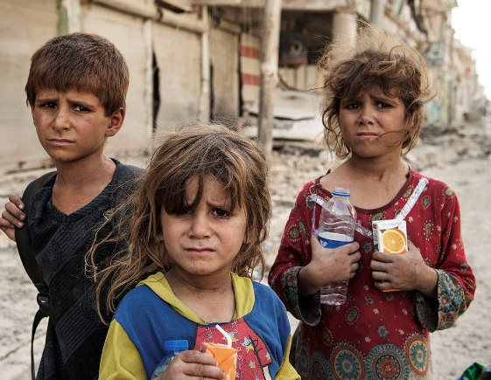
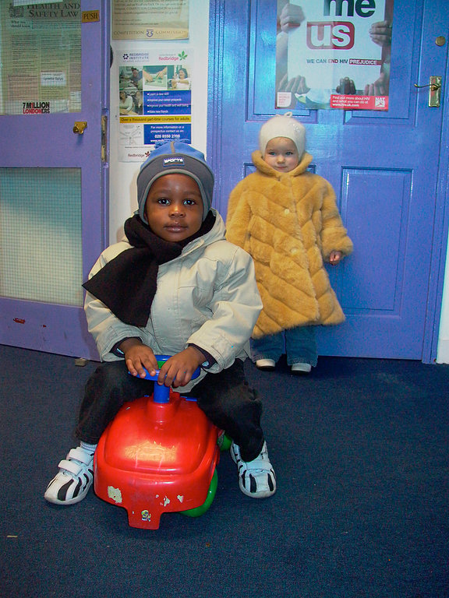
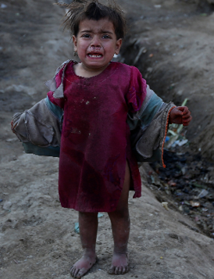
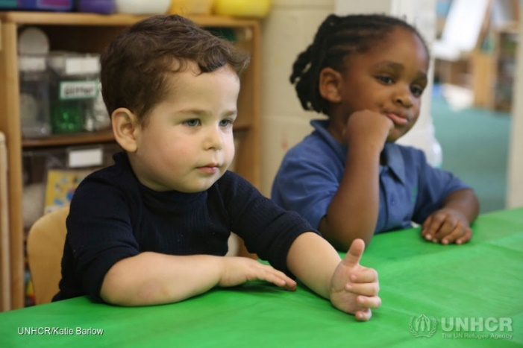
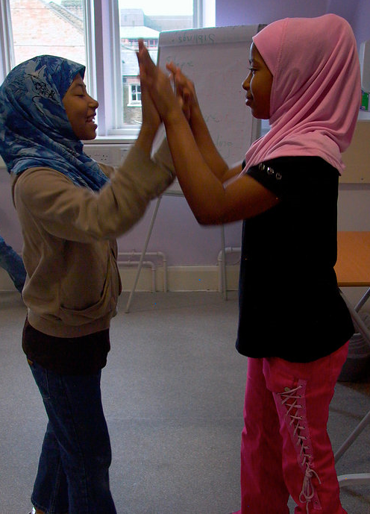
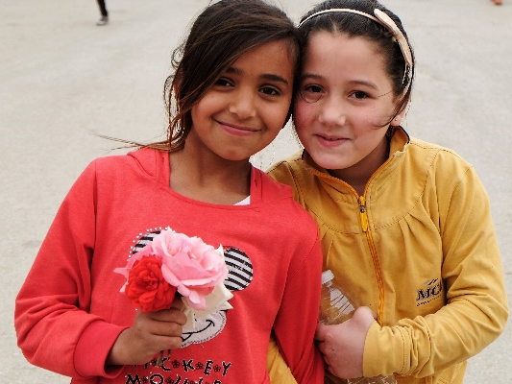
Now look at these images. Which of these children are refugees?
They are all
refugees

Slide 5
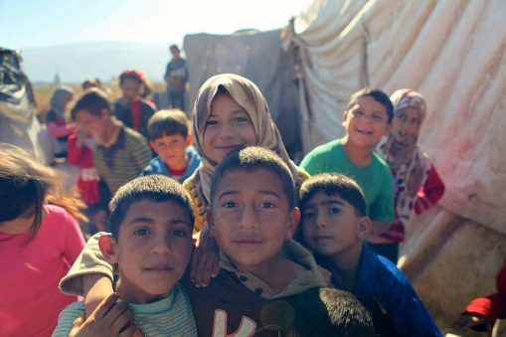
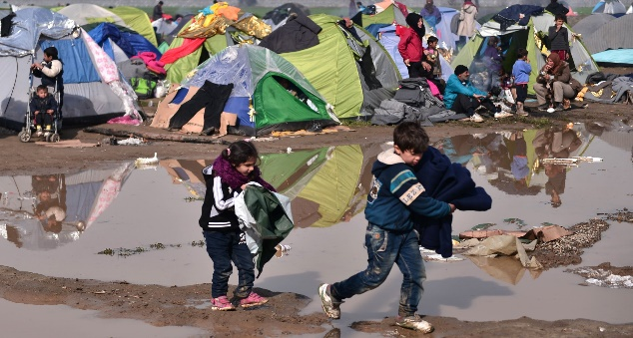
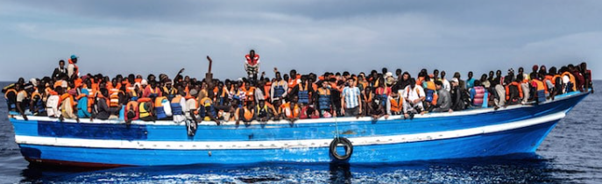
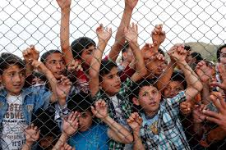
Why might people need to seek refuge?
People become refugees for a number of different reasons, including:
Persecution based on race, religion, nationality, membership of a particular social group or political opinion
War
Ethnic or political violence
Climate or natural disasters
For well over a decade, the number of people forced to flee their homes because of conflict and persecution has steadily increased.
How many child refugees are there in the world?
47 million, are children below the age of 18 (40% of refugees)
Between 2018 and 2023, an average of 339,000 children were born as refugees per year.
Far too many refugee boys and girls are living in conditions not suitable for children, with limited access to education and healthcare, no freedom of movement, and almost entirely dependent on aid.

Slide 6
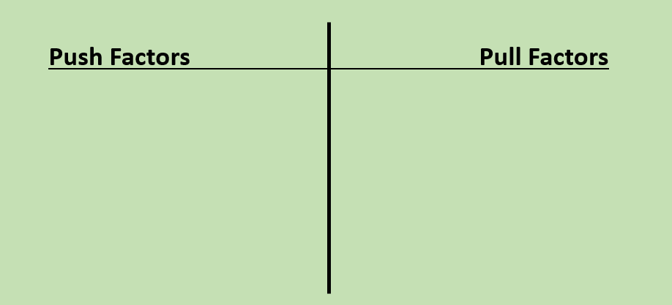
Push and Pull Factors
Push factors are the reasons why people leave an area..
Pull factors are the reasons why people move to a particular area.
Refugees have no choice.
They have to leave their country

Slide 7

TTYP:
Why do you think the author started the story by telling us what Sami’s life is like?
What do we know about Sami?
What similarities are there to Sami’s life and your life?
What differences are there?

Slide 8


Slide 9
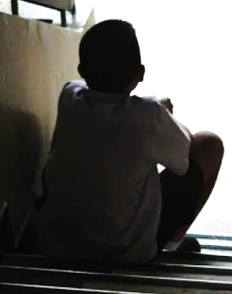
I wish I go the chance to say goodbye…
I wonder how you are doing?
I’m feeling…..
I wonder if….
Do you remember when we….?
I hope you are ok back home…

Slide 10

What are the features of a letter?

Slide 11
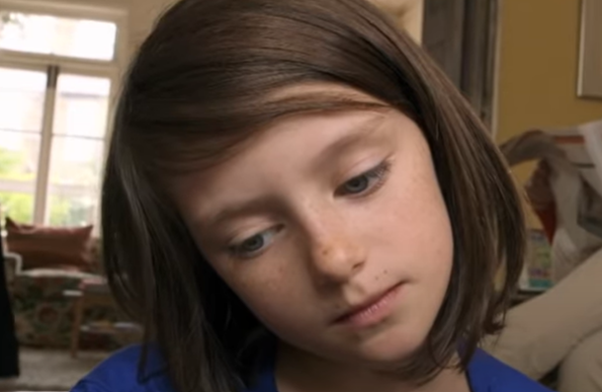
Plenary
https://www.youtube.com/watch?v=RBQ-IoHfimQ

