Slide 1
Session 3

Slide 2

Understand how perceptions based on nonfactual beliefs and generated negative emotional responses can lead to prejudice and hatred.
LO: To present both sides of an argument
SC: I can discuss human rights,
I can listen to and empathise with refugee stories,
I can discuss reasons for and against,
I can write a balanced argument.

Slide 3
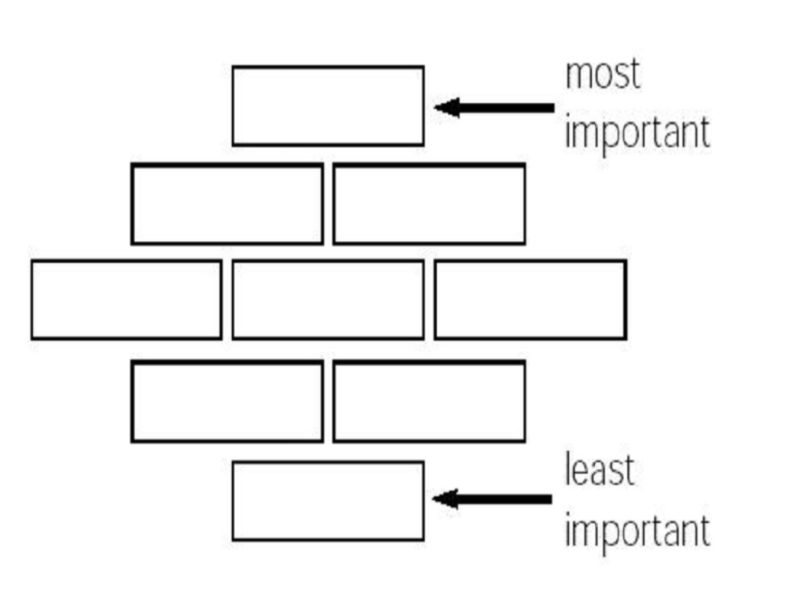
Diamond Nine

Slide 4
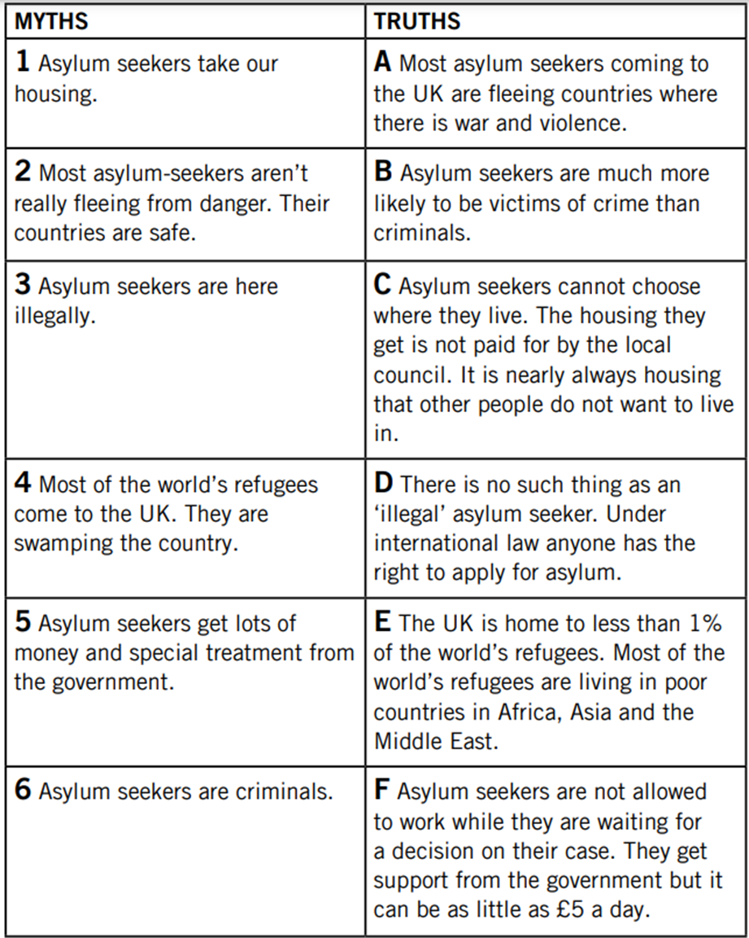

Myths and Truths
In pairs / small group, cut out the myths and truths and match them up.

Slide 5
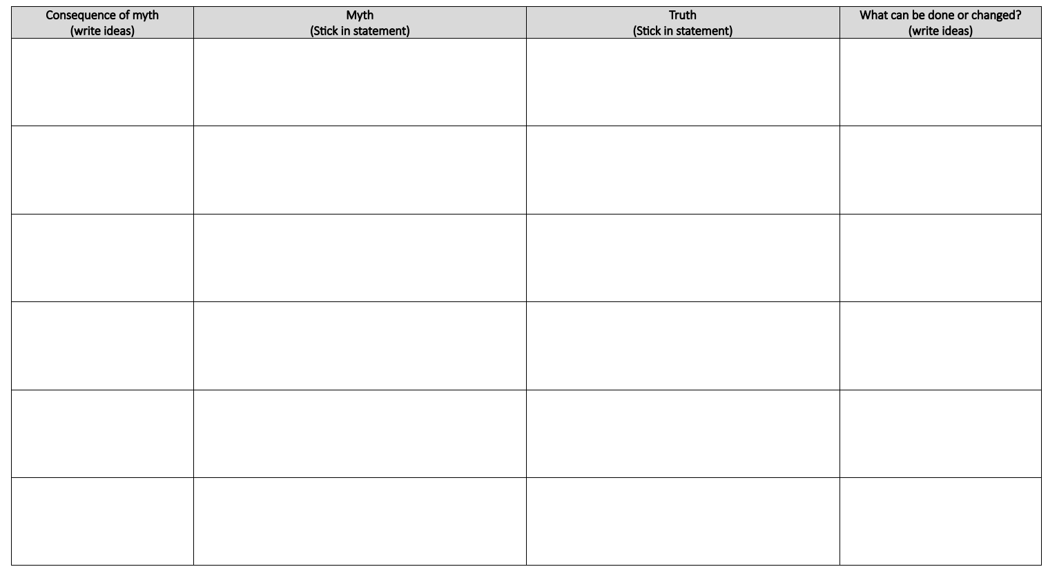
Myths and Truths

Slide 6


Narendra’s Story
Istvan’s Story
Greta’s Story

Slide 7
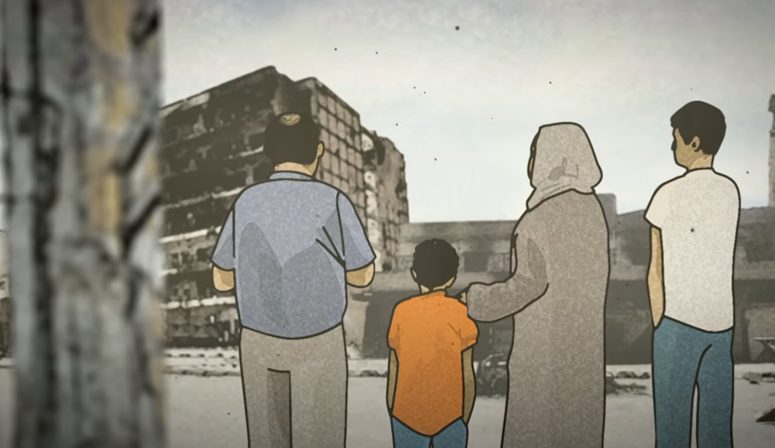

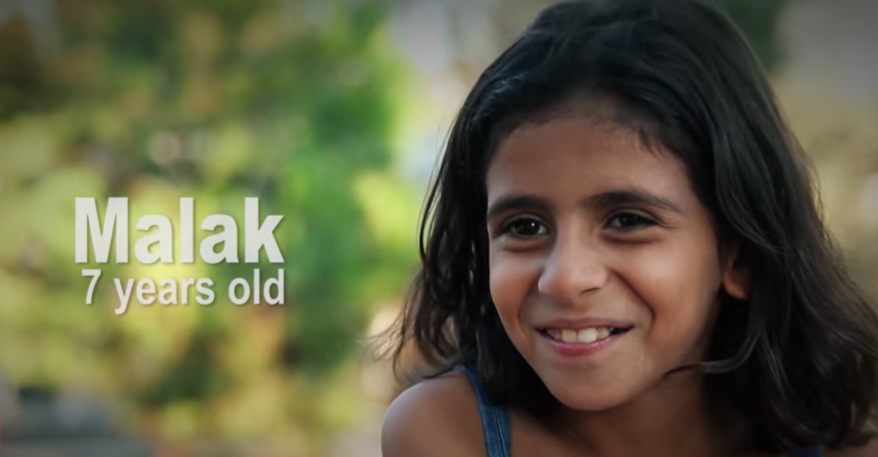
Just like Sami, there are many children who have been forced to flee their home.
https://www.youtube.com/watch?v=B0HWYcFlY-8&feature=youtu.be
https://www.youtube.com/watch?v=-FL5Ham2C-o&feature=youtu.be
https://www.youtube.com/watch?v=UDy8_8L3s0A&feature=youtu.be

Slide 8
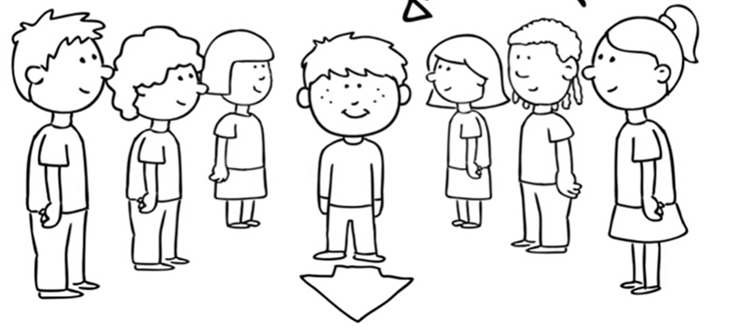
Conscience alley
Was Sami right to try and steal the money from his Baba to help Aadam?
https://www.youtube.com/watch?v=-Hs0LirW9v8

Slide 9
Class List – For and Against
For
Against

Slide 10
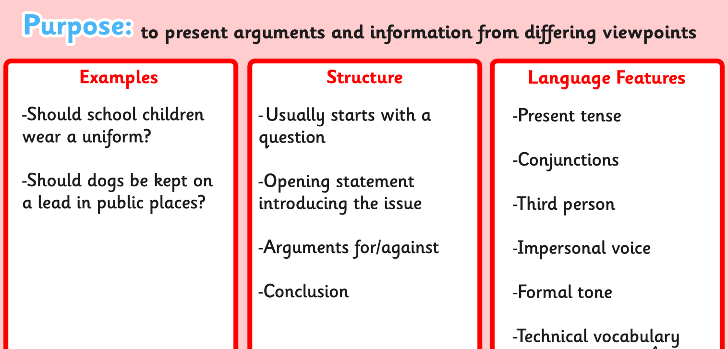
Balanced Argument
Write a balanced argument with reasons for and against. Finish with a conclusion that outlines your decision.
Was Sami right to try and steal the money?

Slide 11
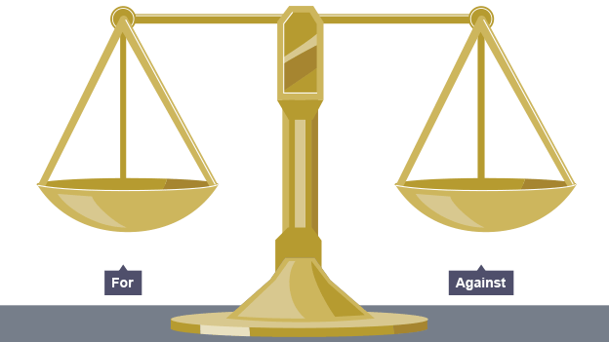
Plenary: Let’s Share - Balanced Argument
Share your balanced argument with your partner.
What do they conclude? Should Sami have taken the money?

