Slide 1
Session 4

Slide 2

Develop an awareness of how right-wing extremist groups can use perceptions based on nonfactual beliefs and generated negative emotional responses, to promote messages of hate.
Confidently discuss the experience of being a refugee and how perceptions based on stereotypes, negative affective responses and non-factual beliefs can lead to prejudice and hatred.
LO: To explore empathy
SC: I can perform poetry,
I can discuss media influences,
I can mind map ideas,
I can write my own poem.

Slide 3


Performance Poetry

Slide 4




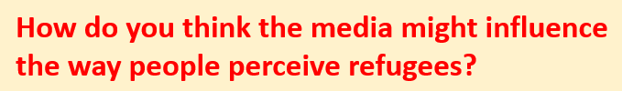

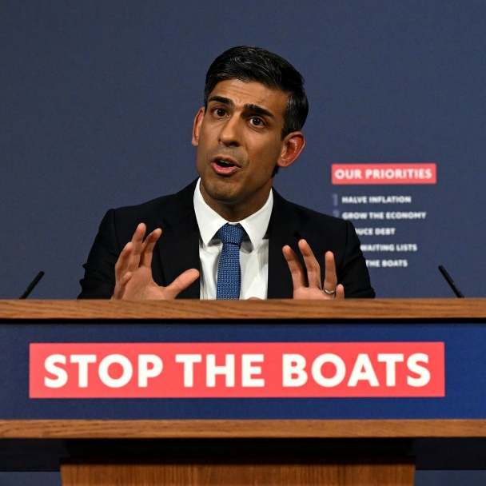

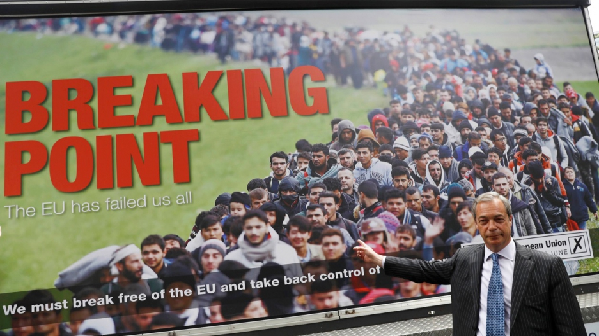



Slide 5
Partner script reading
Read the script with your partner.
One of you will be person A, one will be person B.
Is it a good idea to get all of our information from media? Why / why not?

Slide 6

https://www.youtube.com/watch?v=uK2u57lz9fM&list=PLvnfxJ6uhLqAQ
-a2okvC4R2RzKfxKU1UJ&index=4

Slide 7

When asked why she had written the book ‘Boy Everywhere’, author A. M. Dassu said:
Boy, Everywhere was inspired by a news interview that showed refugees in muddy camps wearing Nike trainers, holding smartphones, and talking about what they’d left behind. Looking around my comfortable living room, I realised that it could easily have been me. Due to media coverage at
the time, many people assumed refugees were poor, uneducated, and wanted to come to Europe
because they’d have a better economic life. But the more Syrian people I met and the more research I did, the more I realised that if it weren’t for the war, most Syrians would never have left. It became clear their lives were very similar to ours in the West, and a civil war could easily bring the same fate upon any of us.

Slide 8
Performance Poetry - Reverse
Now that you have heard the poem in reverse, how do you feel now?
How has it changed?
How can we use the idea of changing the direction of the poem to changing the perception of refugees?

Slide 9

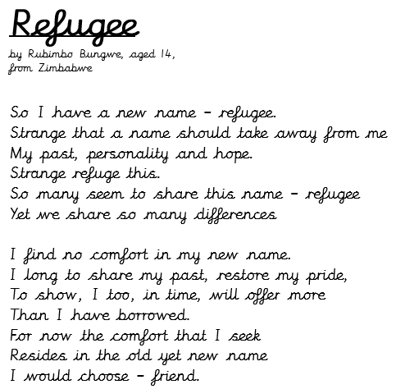
Refugee Poem
I have another poem to share with you….
What does the poem mean?
What is the emotion behind it?
What is the poet trying to say?

Slide 10
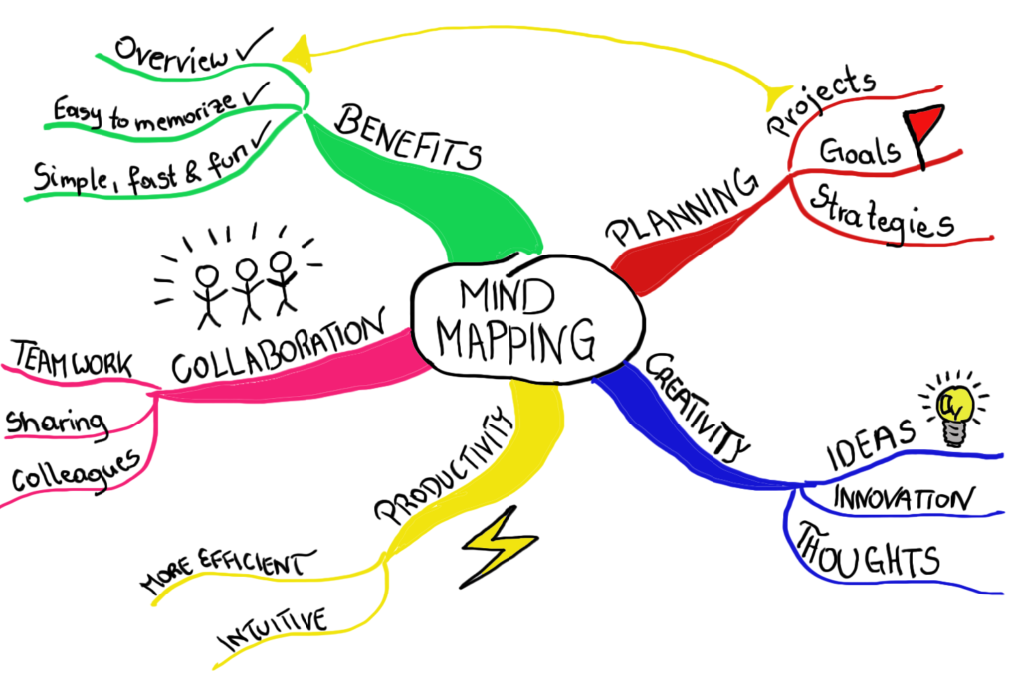
Group Task – Mind map
So, what now?

Slide 11

Your turn…
Using the two poems that we have looked at today, you will need to write your own poem about refugees and the importance of kindness and acceptance. This can be in any poetry style – remember, it doesn’t need to rhyme. The most important thing is that you use language for effect.

Slide 12
Plenary
It’s time to hear some of your poems

