Slide 1

Session 1
Boy Everywhere

Slide 2
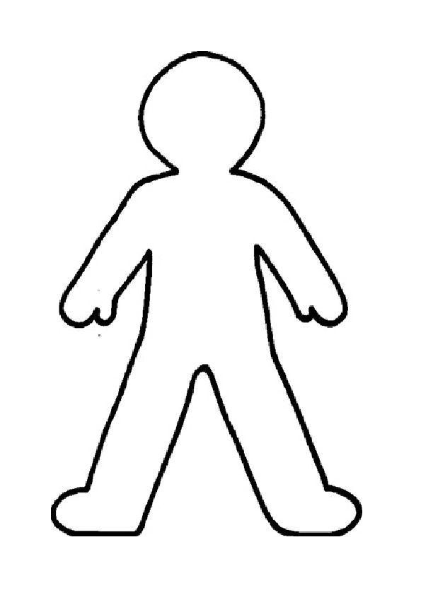
All About Me

Slide 3
Know basic facts about refugees and be able to show empathy around the experience of being a refugee and its impact on the individual and families.
LO: To show empathy
SC:
I can discuss the word refugee,
I can explain what is important to me,
I can label the contents of my backpack.

Slide 4

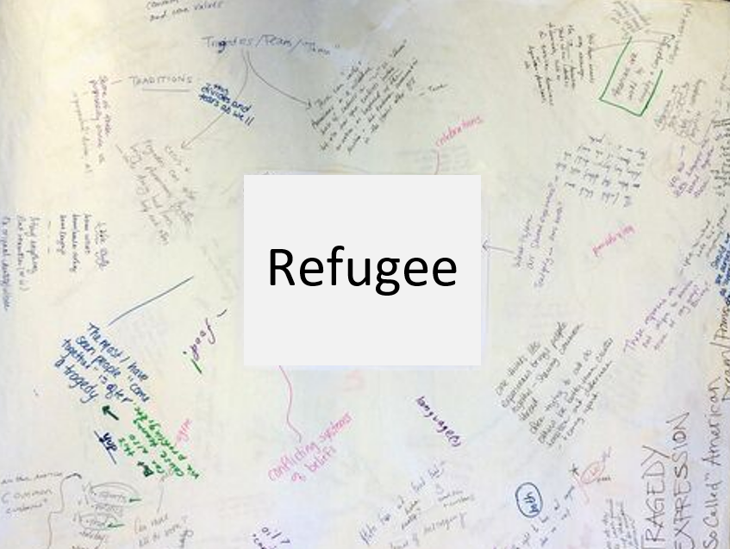

TTYP: What does refugee mean?
Graffiti Wall
Galloping Gallery
Tick once if you like it or agree.
Tick twice if you have written the same thing (or similar)
Put a question mark if you are not sure what it means or if you disagree.

Slide 5
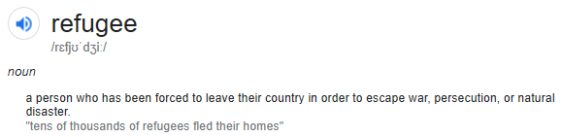
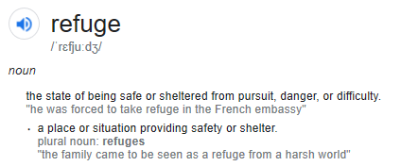
TTYP: What does refugee mean?
To seek refuge means to seek safety from danger, therefore a refugee is someone who has been forced to leave their country in order to be safe.

Slide 6

TTYP:
What do you think this book is about?
What questions do you have?
What can you infer from this image?
In the story, Sami and his family need to flee and cannot take anything with them that they cannot carry in a backpack.

Slide 7
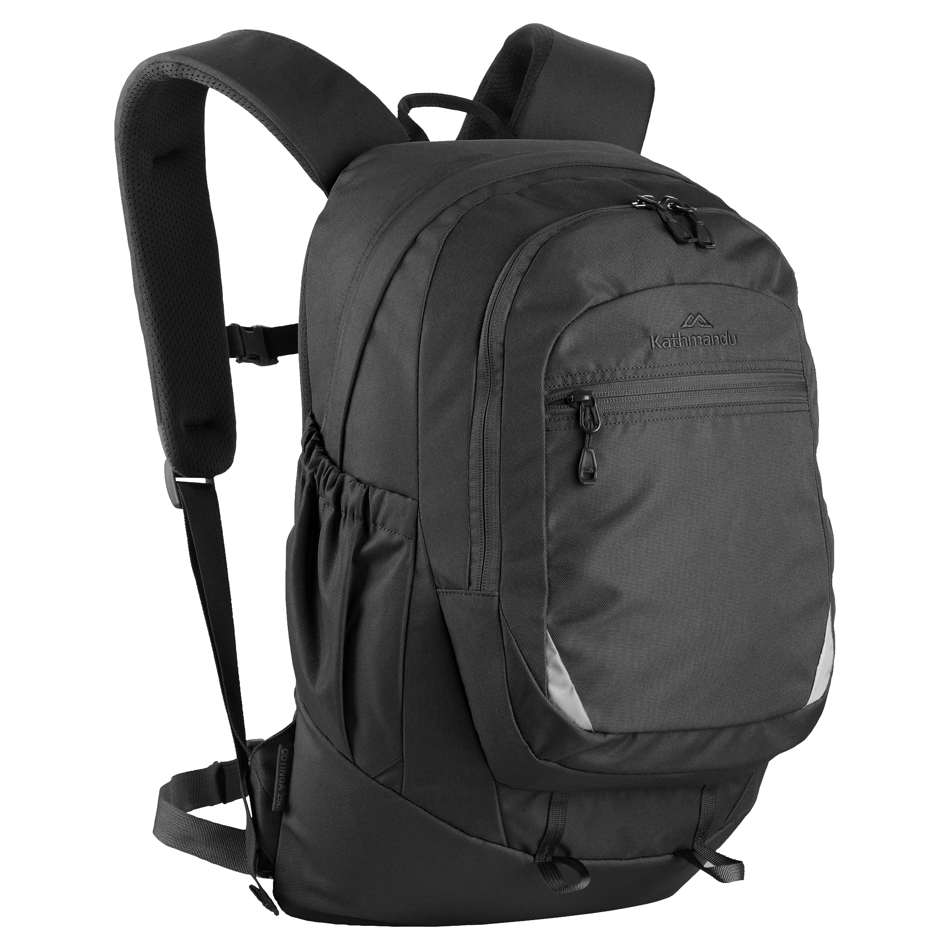

Slide 8
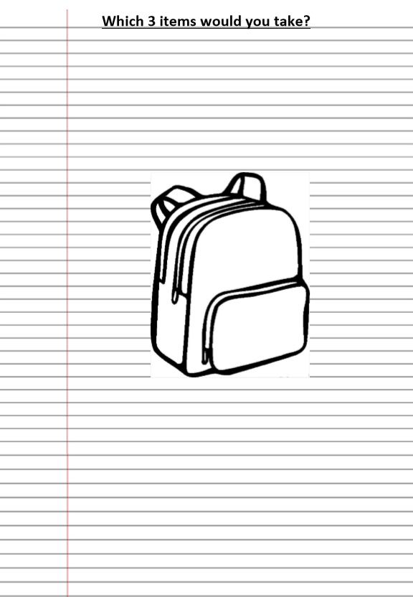
Task: Backpack
Complete the Backpack sheet.
Label your backpack with three things that you would take from home.
For each item, write a detailed explanation of why you chose it and what it means to you.
When complete, you can colour or decorate your backpack.

Slide 9
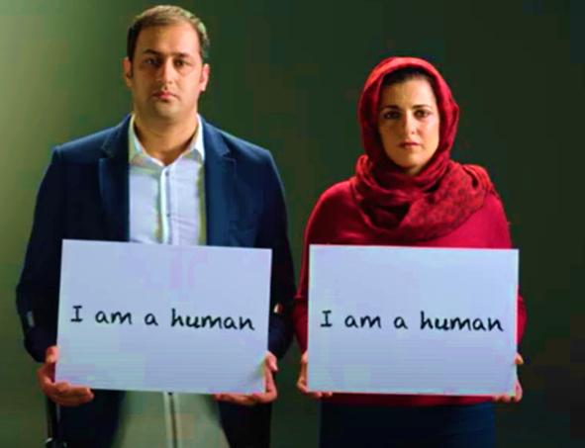
Plenary
https://www.youtube.com/watch?v=sH_1haveiKk

